Slide 1

FISCAL YEAR 25-26 BUDGET ADOPTION
JUNE 3, 2025

Slide 2
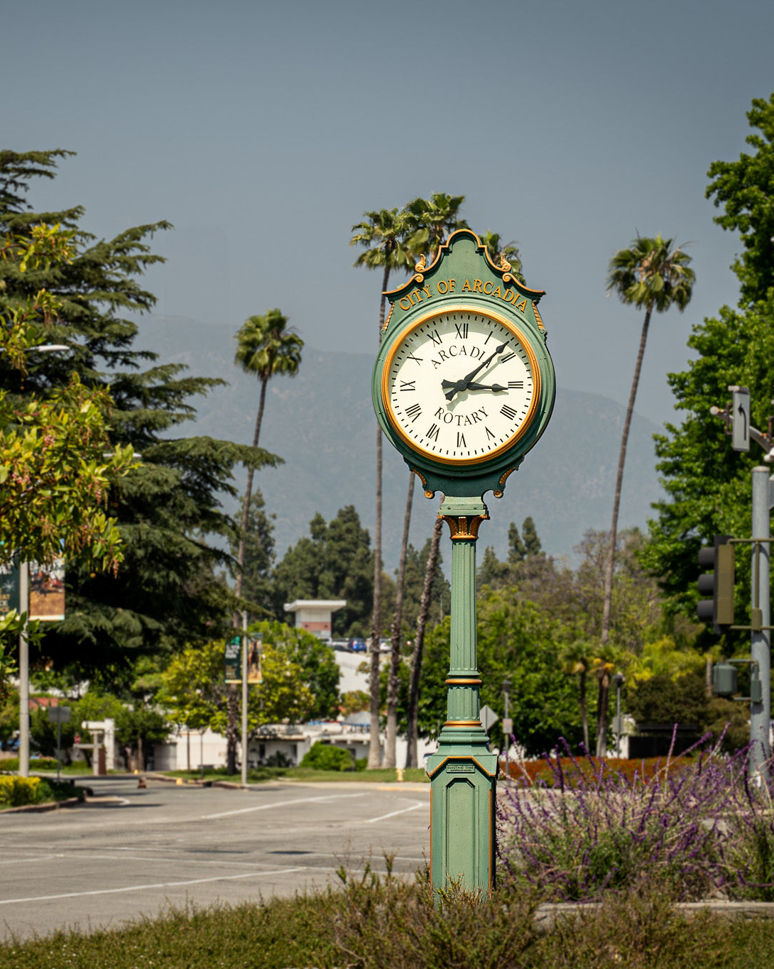

AGENDA
FY 2024-25 General Fund ESTIMATES
FY 2025-26 Proposed Budget
FY 2025-26 Capital & Equipment Funds
New Programs
Budget Challenges

Slide 3

GENERAL FUND FY24-25 ESTIMATES

Slide 4
GENERAL FUND REVENUE SUMMARY FY24-25 ESTIMATES

Slide 5
TAX REVENUES

Slide 6
FY23-24 UNRESTRICTED FUND BALANCE

Slide 7
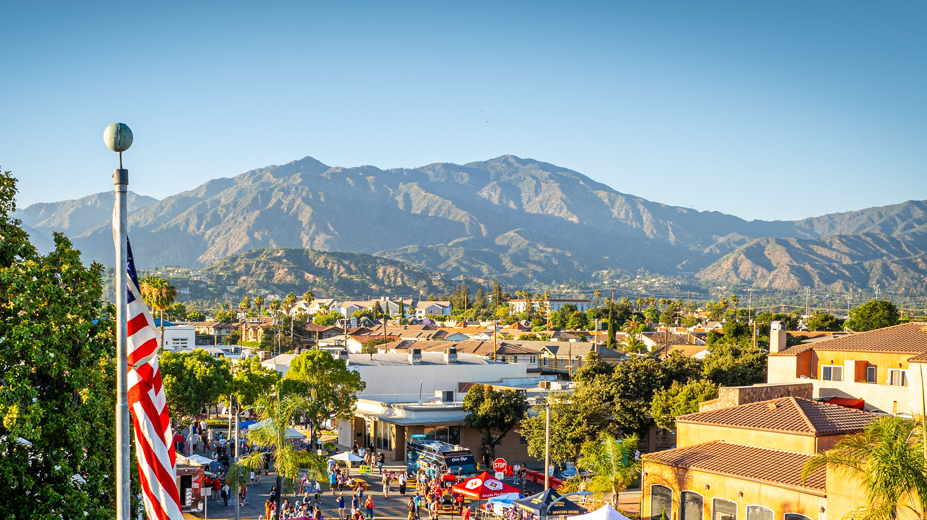
FISCAL YEAR 2025-26
PROPOSED BUDGET

Slide 8
PROPOSED FY25-26 BUDGET

Slide 9
GENERAL FUND REVENUE SUMMARY FY24-25 ESTIMATES

Slide 10
TAX REVENUES

Slide 11

HISTORICAL TRENDS FOR MAJOR TAXES

Slide 12
SALES TAX

Slide 13
PROPERTY TAX

Slide 14
UTILITY USERS TAX

Slide 15
TRANSIENT OCCUPANCY TAX

Slide 16
EXPENDITURE BY CATEGORY

Slide 17
EXPENDITURE BY DEPARTMENT

Slide 18
3-YEAR GENERAL FUND SUMMARY

Slide 19
5-YEAR GENERAL FUND PROJECTIONS
Assumptions:
Revenue Growth 3%
Payroll Increases 3%
Services Increases 3%

Slide 20
FISCAL YEAR 2025-26
NEW PROGRAM REQUESTS

Slide 21
FY25-26 NEW PROGRAMS

Slide 22
FY25-26 NEW PROGRAMS
CITY CLERK
Increase the number of licenses for public viewing of the City’s records portal (Cost - $11,000 General Fund)
POLICE
Provide mental health and performance solutions for individuals that is tailored to the needs of law enforcement personnel. (Cost - $43,700, $28,700 General Fund and $15,000 Grant Funded)

Slide 23
FY25-26 NEW PROGRAMS
FIRE
- Conduct a Standards of Cover (SOC) assessment of the department to assess community risk, evaluate response performance, and identify opportunities for service improvements (Cost - $80,000 General Fund)
- Provide Community Emergency Response Team (CERT) Training to volunteers on how to prepare for disasters and respond to emergency situations (Cost - $12,500 General Fund)

Slide 24
FISCAL YEAR 2025-26
CAPITAL IMPROVEMENT & EQUIPMENT REPLACEMENT FUNDS

Slide 25
CAPITAL IMPROVEMENT

Slide 26
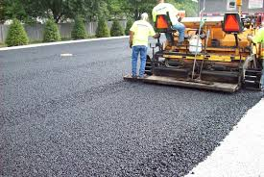
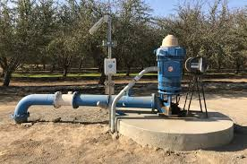
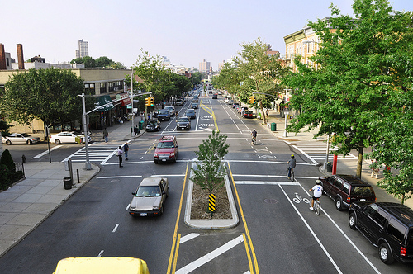
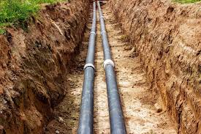
MAJOR CAPITAL PROJECTS
PAVEMENT REHABILITATION
ORANGE GROVE WELL TREATMENT
COLORADO COMPLETE STREETS
SEWER MAIN REPLACEMENT
$2,500,000
$6,000,000
$4,500,000
$1,350,000

Slide 27
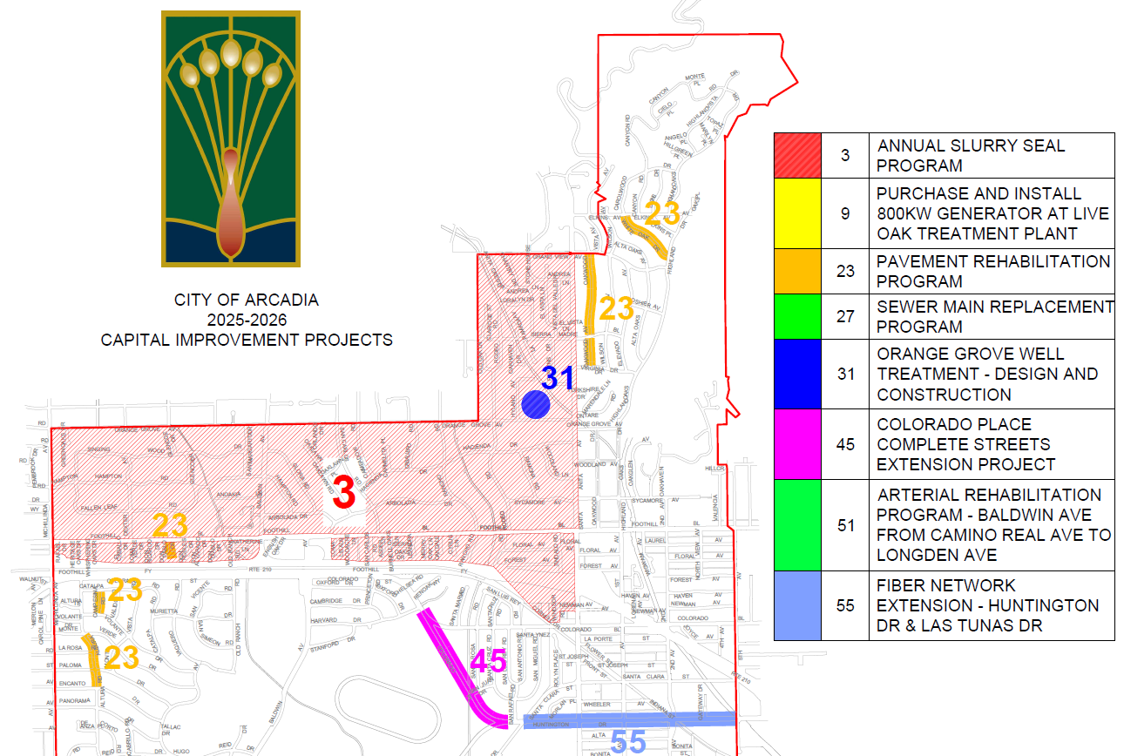

Slide 28
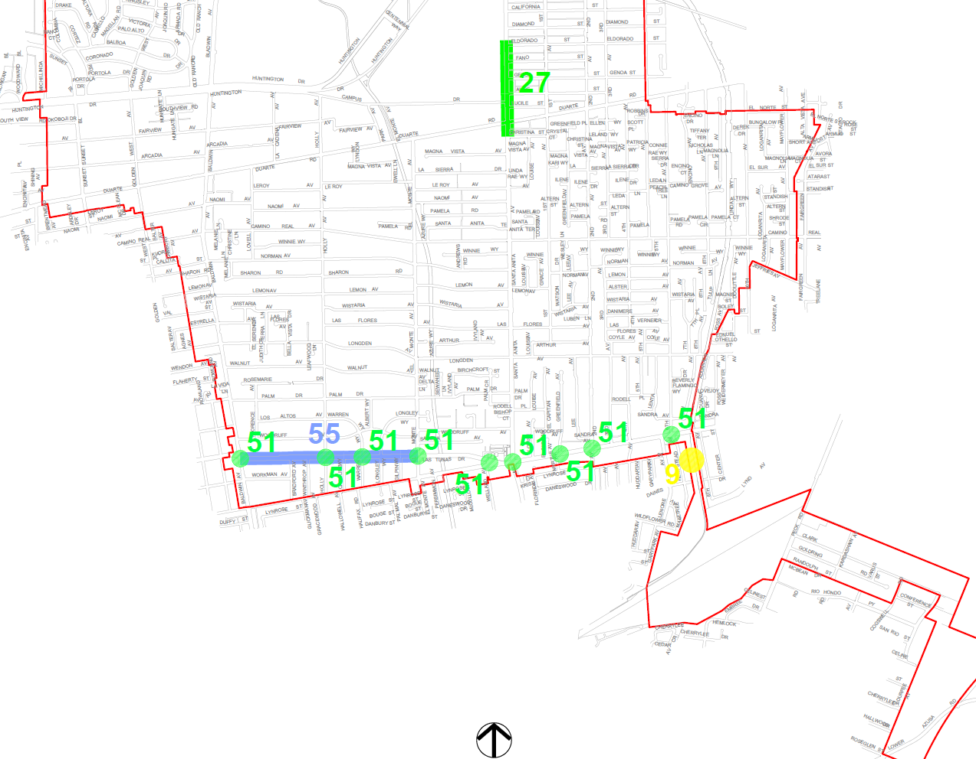
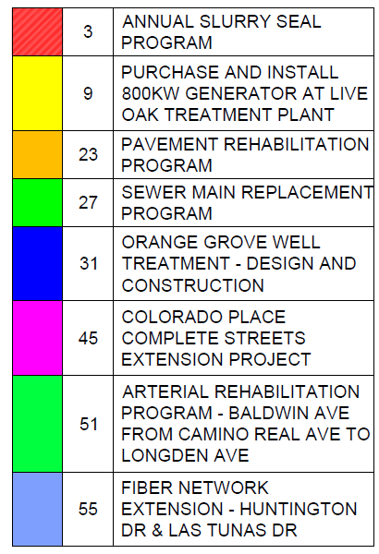

Slide 29
CAPITAL FUND BALANCES

Slide 30
CAPITAL FUND BALANCE PROJECTIONS

Slide 31
EQUIPMENT REPLACEMENT

Slide 32
EQUIPMENT REPLACEMENT
Surveillance Trailers $106,400
Water Vehicle Replacement $636,900
Police Vehicle Replacement $451,100
Streets Vehicle Replacement $273,700
Radio Replacement $460,000
Water 175 kW Generator $195,000

Slide 33
EQUIPMENT FUND BALANCES

Slide 34
EQUIPMENT FUND BALANCE PROJECTIONS

Slide 35
BUDGET CHALLENGES

Slide 36

ECONOMIC UNCERTAINTY
The global economy is facing high levels of economic uncertainty. This uncertainty is fueled by rapid economic policy shifts, trade tensions, and financial turbulence.
This makes difficult any assumptions about long-term trends.

Slide 37
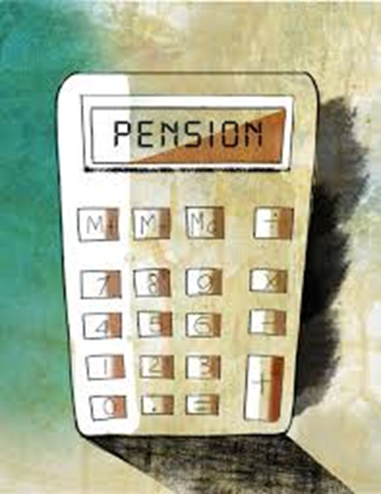
PENSION COSTS
Investment returns of CalPERS are heavily influenced by economic and market conditions. Historically, CalPERS have outperformed their discount rate of 6.8%. In the short term, however, economic volatility will impact their returns and that can have a significant impact on the City’s pension costs and our budget

Slide 38

BUDGET SUMMARY
BALANCED BUDGET FOR FY 2025-26
  No reduction in service levels
  No reduction in staffing levels
CONTINUE TO INVEST IN THE FUTURE
  $500K Transfer to Other Post Employment Benefits (OPEB) Fund
  $500K Transfer to Pension Stabilization Fund
  $4.8M Transfer to the Equipment and Capital Project Funds
CONTINUE TO MAINTAIN 20% RESERVE OF THE GENERAL FUND BUDGET

Slide 39
RECOMMENDATIONS
APPROVE RESOLUTION NO. 7638 – adopting a budget for Fiscal Year 2025-26 and appropriating the amounts specified therein as expenditures from the Funds.
APPROVE RESOLUTION NO. 7639 – adopting a Capital Improvement and Equipment Plan for the Fiscal Year 2025-26 through 2029-30
Authorize and direct the City Manager to make discretionary transfers not to exceed $10 million from Fiscal Year 2024-25 General Fund Operating Budget to the Capital Improvement, Equipment Replacement, OPEB Trust and Pension Stabilization Funds

Slide 40



Questions?
@ArcadiaCAgov

